Slide 1
Lead-Scoring Case Study
Submitted by
Aneesa ayaz
Data science c10 global batch

Slide 2
PROBLEM STATEMENT
An education company named X Education sells online courses to industry professionals. On any given day, many professionals who are interested in the courses land on their website and browse for courses.
The company markets its courses on several websites and search engines like Google. Once these people land on the website, they might browse the courses or fill up a form for the course or watch some videos. When these people fill up a form providing their email address or phone number, they are classified to be a lead. Moreover, the company also gets leads through past referrals. Once these leads are acquired, employees from the sales team start making calls, writing emails, etc. Through this process, some of the leads get converted while most do not. The typical lead conversion rate at X education is around 30%.
Now, although X Education gets a lot of leads, its lead conversion rate is very poor. For example, if, say, they acquire 100 leads in a day, only about 30 of them are converted. To make this process more efficient, the company wishes to identify the most potential leads, also known as ‘Hot Leads’. If they successfully identify this set of leads, the lead conversion rate should go up as the sales team will now be focusing more on communicating with the potential leads rather than making calls to everyone

Slide 3
I do the this assignment as following steps
STEP 1: Importing data
STEP2: Inspecting data
Dataframe shape(9240 rows and 37 columns
Dataframe information like how many non null entries and it data types
Statistical information of numerical data
STEP 3:EXPLORATORY DATA ANALYSIS
I have done dropping unique value columns like prospect ID, lead number.Missing value treatment like dropping all columns more than 45% of data.The columns with less than 45% missing values I chose to fill the missing values with NOT AVAILABLE value
Then we have done univariate and bivariate analysis

Slide 4
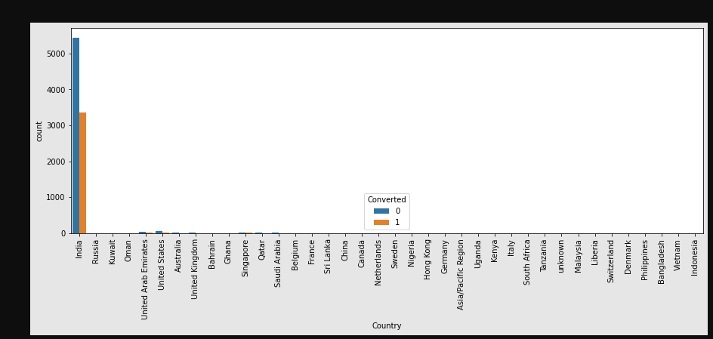
UNIVARIATE AND BI VARIATE ANALYSIS
FOR COUNTRY COLUMNS-India has high values like more than 97%

Slide 5
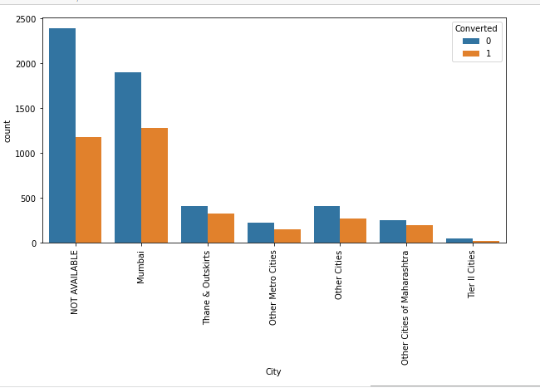
For city column

Slide 6
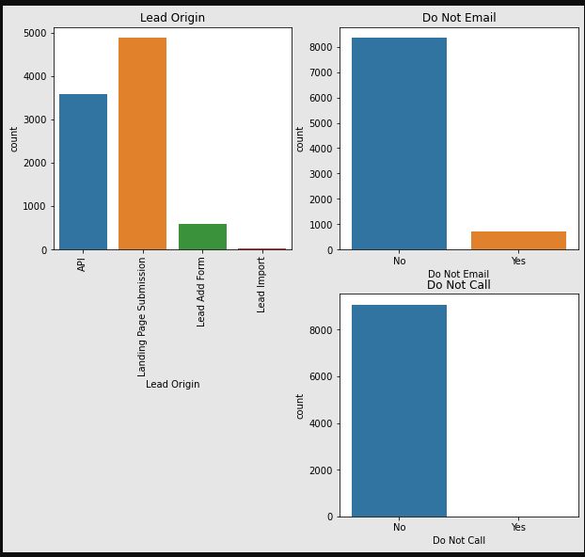
Plot for lead origin,do not call and do not email.i chose to use subplot

Slide 7
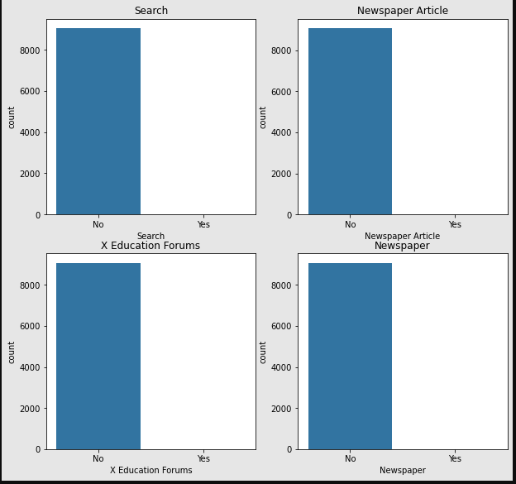
Subplot for search,Newspaper Article,X education forum and Newspaper

Slide 8
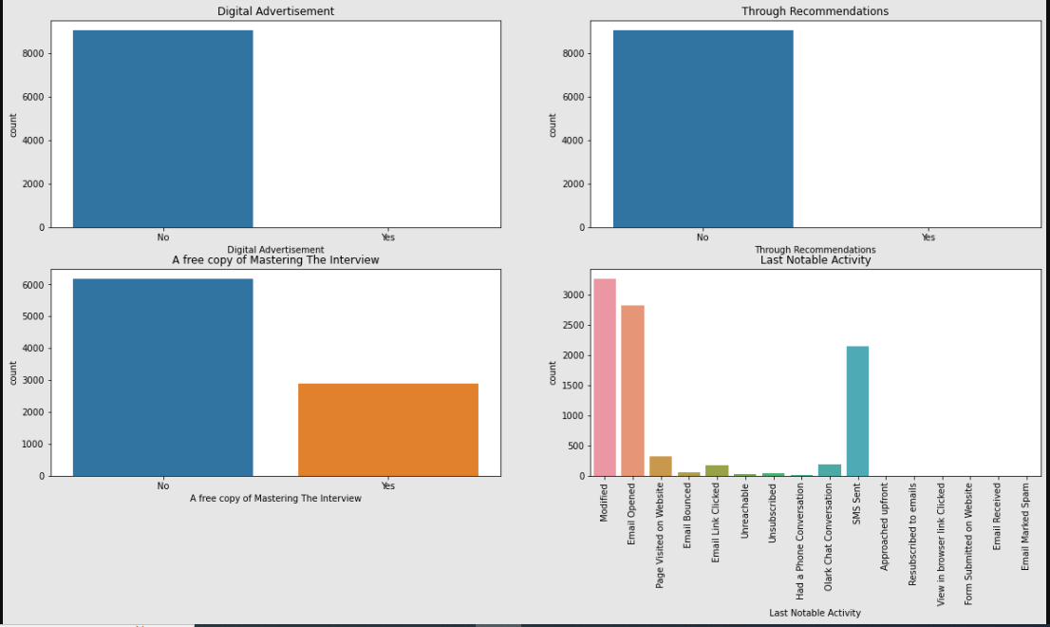
Subplot for Digital advertisement,Through recommendations,A free copy of mastering the interview and last notable activity

Slide 9
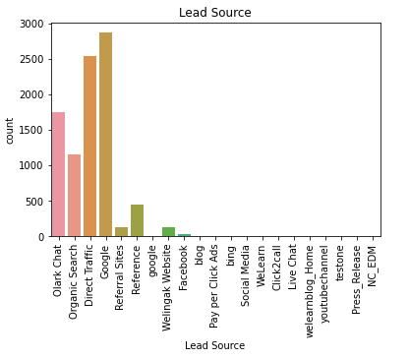
From the plot for lead source we can see that google has more lead

Slide 10
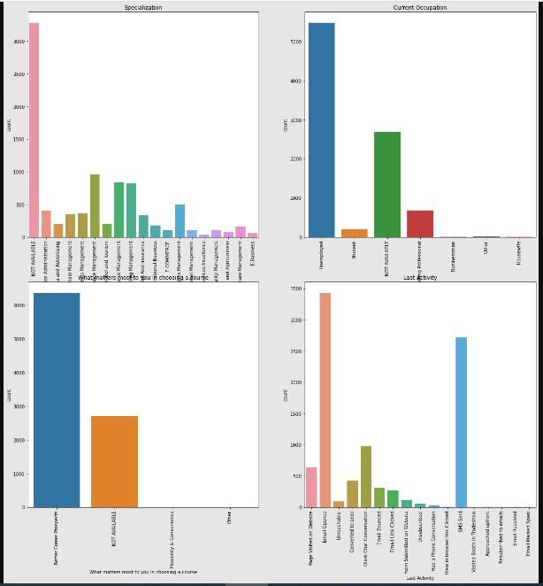
Subplot for Specialization,What is your current occupation and last activity

Slide 11
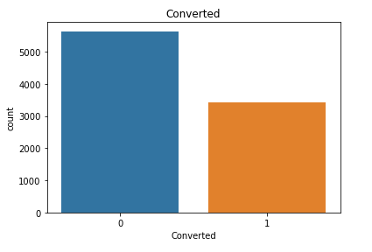
Plot for Converted-No has high value

Slide 12
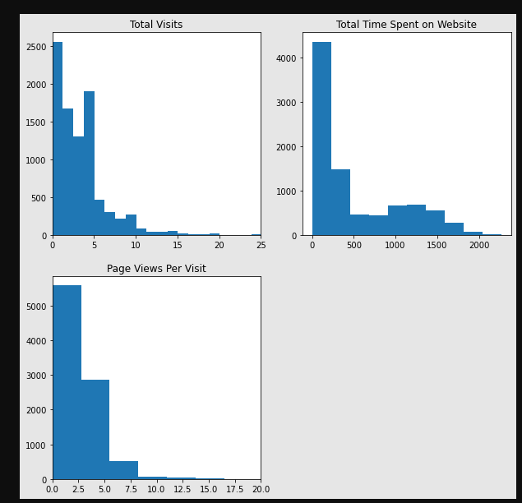
Plot for total visit, total time spent on website ,page views per visit

Slide 13
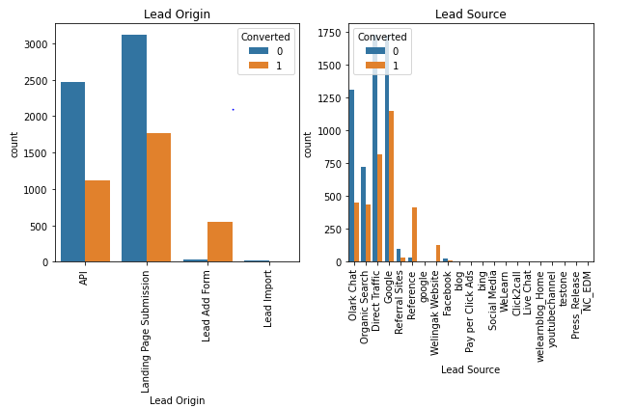
Bivariate analysis-Categorical variable(lead orogin and lead source) vs Converted

Slide 14
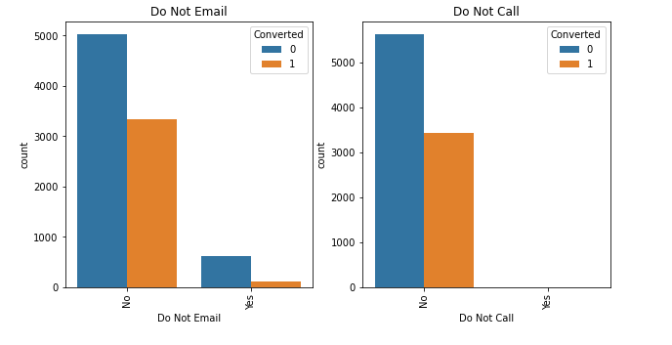
Do not email and do not call vs Converted

Slide 15
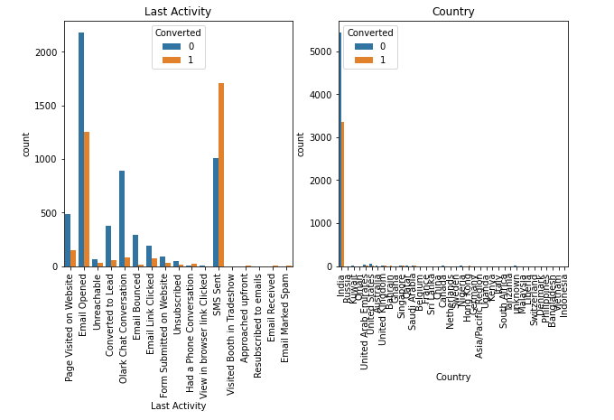
Last activity and country vs Converted

Slide 16
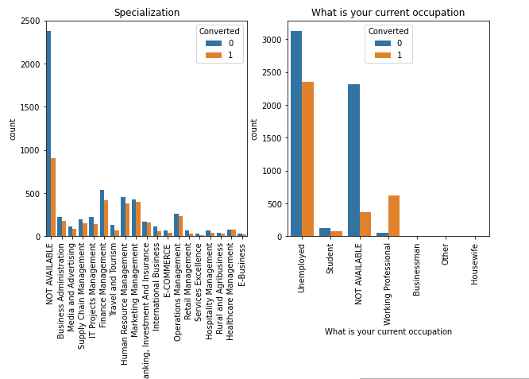
Specialization and What is current occupation Vs Converted

Slide 17
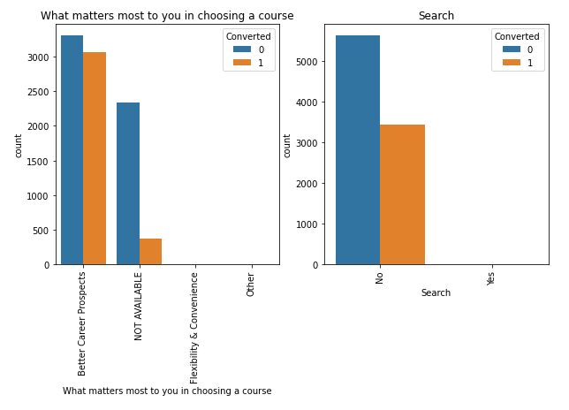
What matters most to you choosing a course and Search Vs Converted

Slide 18
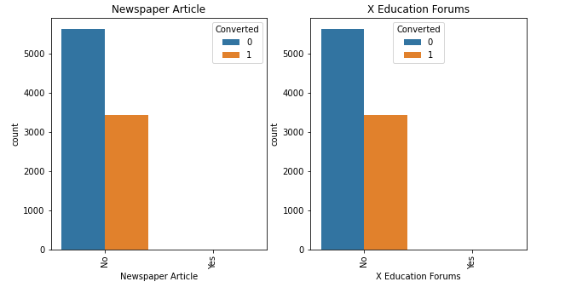
News paper Article and X education forums vs Converted

Slide 19
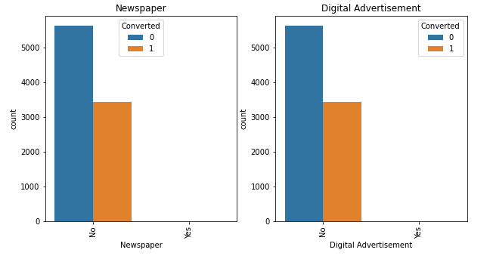
Plot for newspaper and didgital advertisement Vs Converted

Slide 20
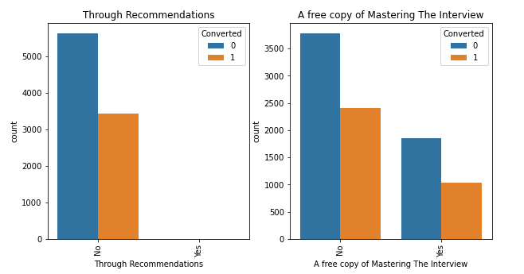
Through recommentations and A free copy of mastering the interviews Vs Converted

Slide 21
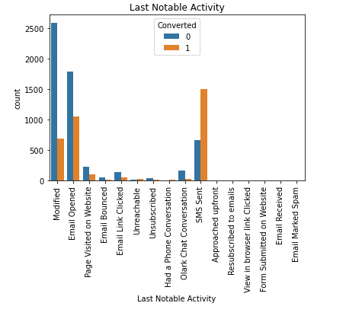
Last mobile activity Vs Converted

Slide 22
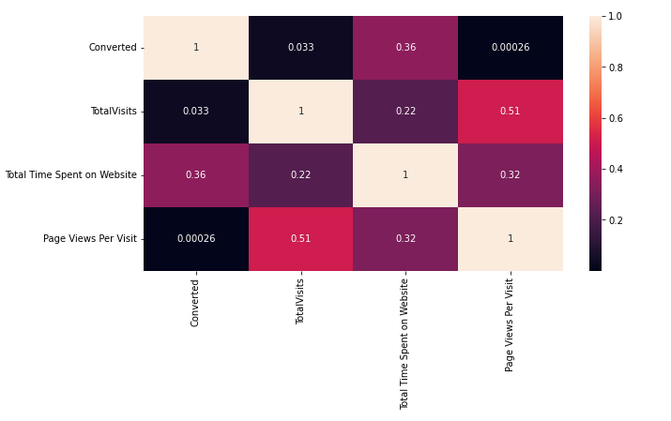
Heatmap for corelation table –We can see that some attributes have some correlation

Slide 23
STEP 4:Data prepration
In this step dropping all unique value columns.May be it will increase the model accuracy.
Creating dummy variables all categorical values by using get_dummies()

Slide 24
STEP 5:Split train and test set
The split was done at 70% and 30% for train and test data respectively.
STEP 6:Feature scaling
We will do min-max scaling on the variables ['TotalVisits', 'Page Views Per Visit', 'Total Time Spent on Website']
STEP 7:Model Building
RFE was used for feature selection.
Then RFE was done to attain the top 15 relevant variables.
Later the rest of the variables were removed manually depending on the VIF values and p-value.
A confusion matrix was created, and overall accuracy was checked which came out to be 81%.
We made 3 models to get VIF and P value optimized which is VIF<5 and P value<0.05

Slide 25
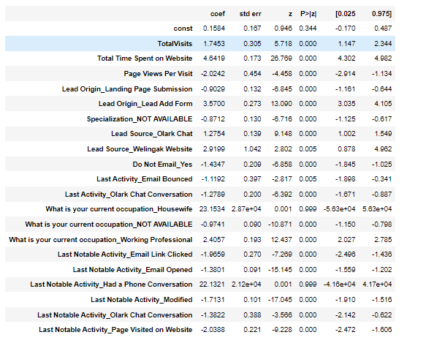
Model 1-The regression result

Slide 26
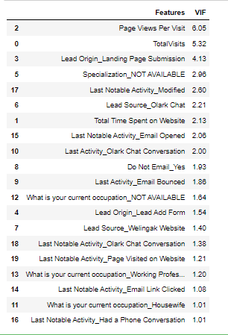
VIF table

Slide 27
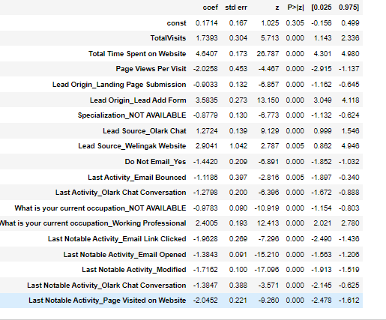
Model 2-The regression result

Slide 28
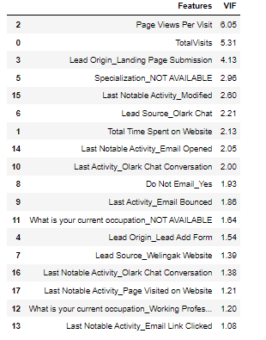
VIF table

Slide 29
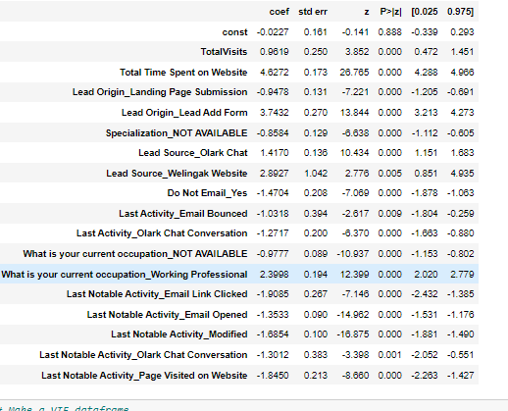
Model 3:The regression table

Slide 30
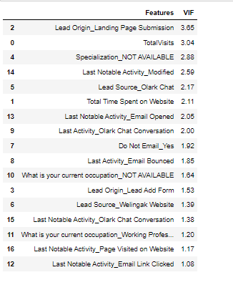
VIF table-From the last Regression result and VIF table we can see that every values are in control

Slide 31
STEP 8:Creating prediction
Predicting the probabilities on the train set
STEP 9:Model evaluation
With randomly selected cut off value 0.5 we got sensitivity 71%,specificity 89% and accuracy 82%
We have to find the optimal cut off value with ROC curve.The above values are looking good but the three values should be almost equal

Slide 32
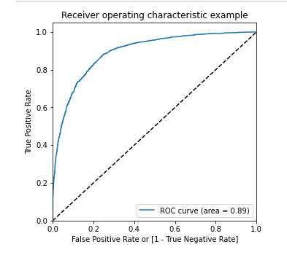
The ROC curve-The value under the curve is 89% which is very good.The high ROC curve value means model is good

Slide 33
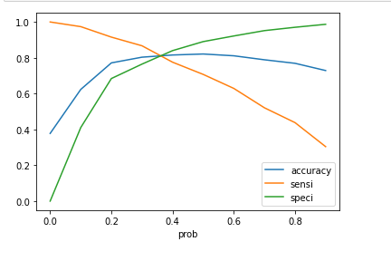
Then we plot the values of different probabilities bucket and we get the below graph.From the graph we can see that optimal cut off value is .35

Slide 34
Rechecking the values of sensitivity,specificity amd accuracy with the optimal cut off range value 0.35
Accuracy-81%
Sensitivity-82%
Specificity -81%
STEP 10:Making prediction on test set
we get
Accuracy 81%
Sensitivity 82%
Specificity 81%

Slide 35
CONCLUSION
TOP VARIABLE CONTRIBUTING TO CONVERSION:
LEAD SOURCE:
Total Visits
Total Time Spent on Website
Lead Origin:
Lead Add Form
Landing Page Submission
Lead source:
Olark Chat
Welingak website
Last Activity:
Do Not Email_Yes
Last Activity_Email Bounced
Olark chat conversation
The Model seems to predict the Conversion Rate very well and we should be able to give the Company confidence in making good calls based on this model.
Keeping these in mind the X education can flourish as they have a very high chance to get almost all the potential buyers to change their mind and buy their courses

Slide 36
THANK YOU

